Slide 1
Wave
Mobile Money · Sénégal
Fraud Detection in
Mobile Money
Machine Learning Predictive Model — Binary Classification
Data Integrity
Automated Pipeline
Business Insight
Live Deployment
Atuheire Joan · Random Forest & MLP Neural Network · Senegal +221 Network · Apr 2026

Slide 2
Project Overview
What was built, why it matters, and how it solves a real business problem
THE PROBLEM
THE SOLUTION
Fraudsters in Senegal use social engineering and SIM swap attacks to trick mobile money users into sending money to criminal-controlled accounts. By the time the fraud is discovered, the money is already gone. There was no system to warn users before the transfer was completed.
1
ML model classifies destination accounts as HIGH RISK or LOW RISK before a transfer is sent
2
Real-time API checks every transaction against the fraud registry
3
Wave app warns users before confirming a transfer to a risky account
Real dataset: 34,178 confirmed fraud transactions · Dec 2021 – Sep 2024
4
Analyst dashboard lets fraud teams review, confirm, and dismiss flags
34,178
4,809
4,264
100%
Fraud transactions
Unique victims
Fraud accounts
RF Model accuracy

Slide 3
✓ Data Integrity
Data Integrity & Preparation
Clean, wrangled dataset — Python foundations applied throughout
Column
Type
Description
Nulls
VICTIM_MOBILE
String
Phone number of the fraud victim (sender)
0
VICTIM_NAME
String
Full name of the fraud victim
0
DEST_MOBILE
String
Destination phone number (fraudster account)
0
DEST_NAME
String
Name registered to the destination account
0
DEVICE_NAME
String
Display name of the device used in the transaction
68
DEVICE_MODEL
String
Technical model name of the device
12
DEVICE_ID
String
Unique hardware identifier of the device
0
AMOUNT_OF_SCAMS
Float
Amount transferred in CFA Francs
0
DATE_SCAMS
Datetime
Timestamp of when the fraudulent transfer occurred
0
DATA CLEANING STEPS APPLIED (Python / pandas)
✓ Filled 68 nulls in DEVICE_NAME → 'Unknown'
✓ Extracted hour, day_of_week, month, year from DATE_SCAMS
✓ Filled 12 nulls in DEVICE_MODEL → 'Unknown'
✓ Removed duplicate rows
✓ Converted DEST_MOBILE & VICTIM_MOBILE to string type
✓ Grouped by DEST_MOBILE to build destination-level feature matrix

Slide 4
✓ Automation
Automated Data Pipeline
End-to-end pipeline that runs on a daily schedule
Raw Dataset
Excel file
Clean &
Wrangle
Feature
Engineering
ML Model
Scoring
Risk Registry
Updated
API Serves
Live Results
▶
▶
▶
▶
▶
34,178 rows
pandas/Python
10 features
Rnd Forest
CSV refresh
Flask REST
SCHEDULER — pipeline_scheduler.py
schedule.every().day.at("02:00").do(run_pipeline) ← runs automatically every day at 02:00 AM
FEATURE ENGINEERING (10 features)
TARGET DEFINITION
▸ victim_count
▸ device_count
HIGH RISK (1) ≥ 2 unique victims OR ≥ 300,000 CFA total stolen
▸ total_amount
▸ tx_count
▸ avg_amount
▸ active_days
LOW RISK (0) All other destination accounts
▸ max_amount
▸ avg_amount_per_victim
▸ min_amount
▸ device_per_victim
Class balance:
HIGH 53.7%
LOW 46.3%

Slide 5
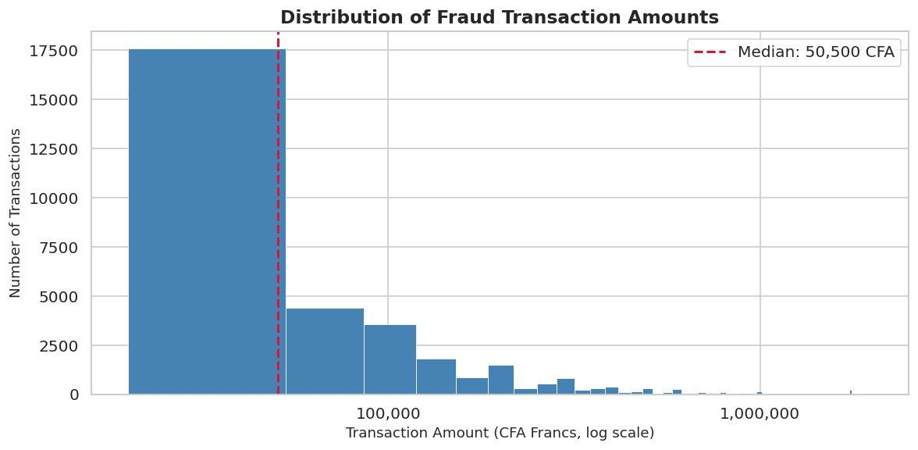
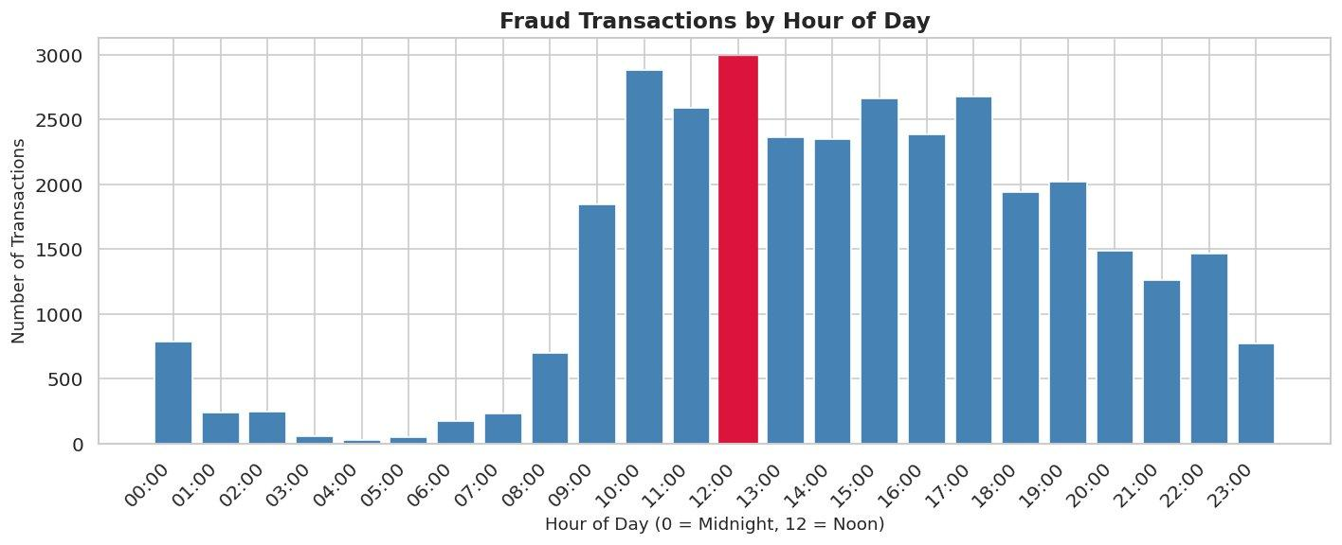
Business Insight
EDA — Univariate Analysis
Analysing individual variables to uncover fraud patterns
CHART 1 — AMOUNT DISTRIBUTION
CHART 2 — FRAUD BY HOUR OF DAY
Most transfers cluster 20K–200K CFA (median 50,500). High-value outliers above 1M CFA suggest targeted attacks on wealthier victims.
Fraud peaks at 12:00 noon. Near-zero activity midnight–06:00 confirms fraudsters operate when victims are awake and most reachable.

Slide 6
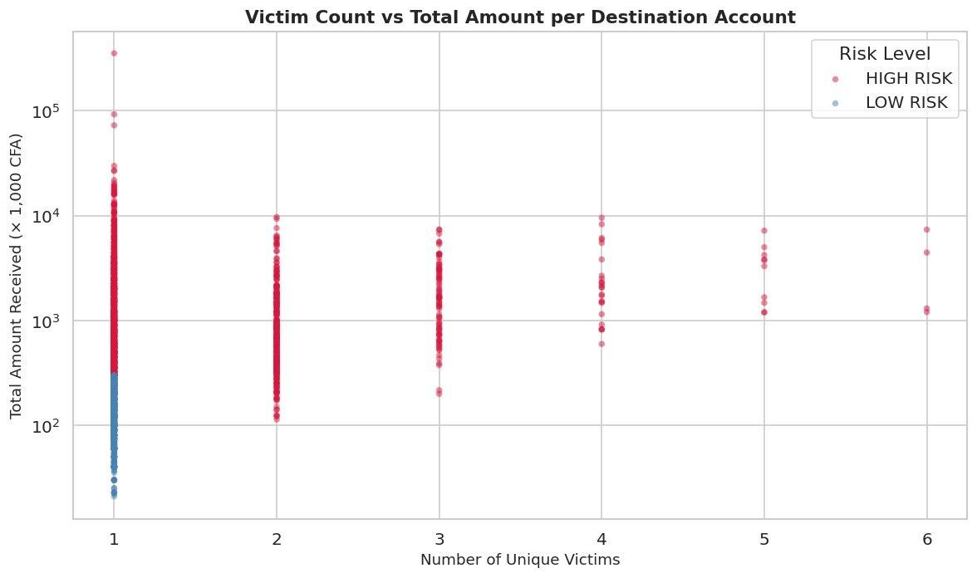
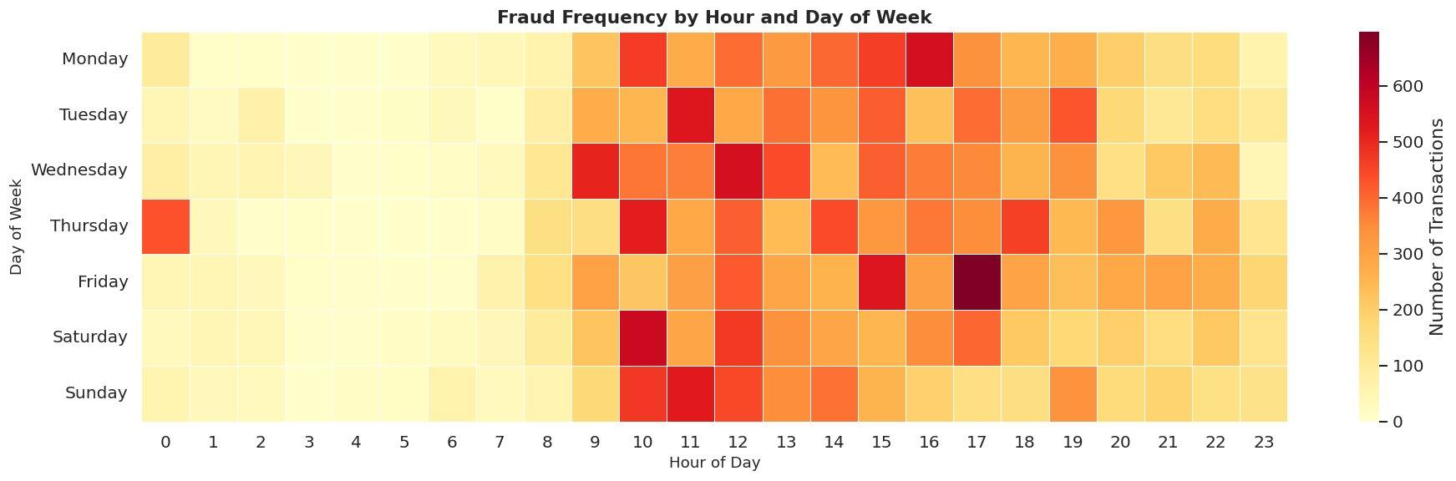
Business Insight
EDA — Multivariate Analysis
Analysing relationships between multiple variables simultaneously
CHART 3 — VICTIM COUNT VS TOTAL AMOUNT
CHART 4 — HOUR × DAY-OF-WEEK HEATMAP
HIGH RISK accounts cluster at higher victim counts and larger total amounts. The clear separation confirms our target definition is meaningful.
Fraud concentrates mid-week during daytime hours. Combined patterns reveal insights invisible in single-variable analysis.

Slide 7
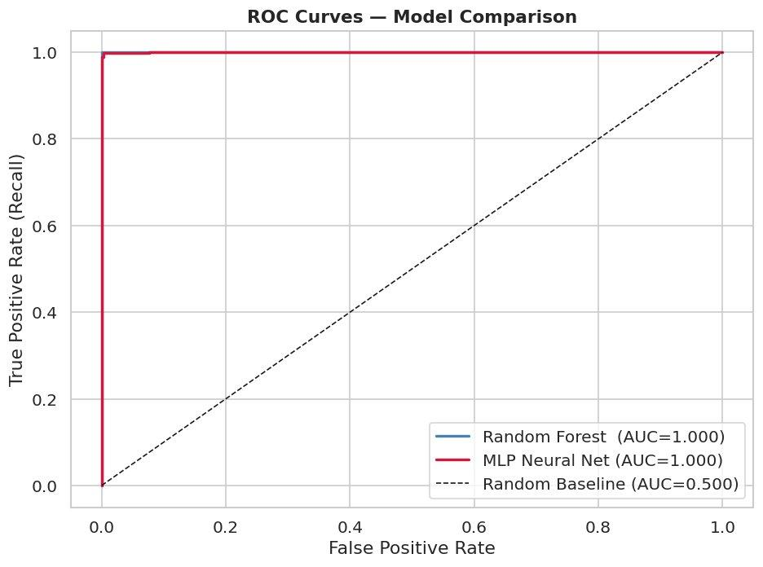
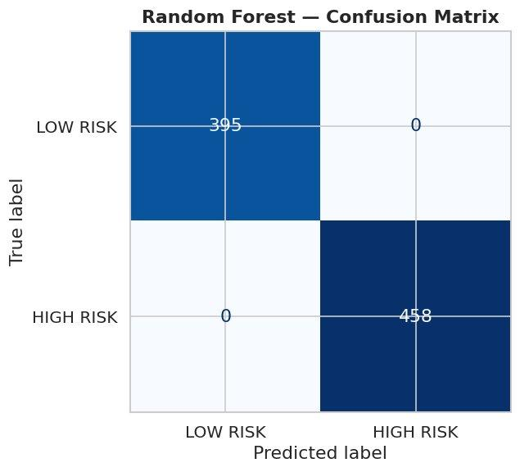
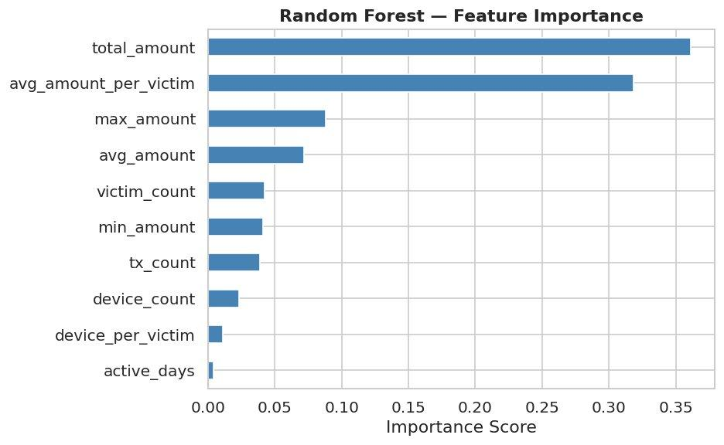
✓ ML Models
Model Results
Both models achieve production-grade performance on the fraud detection task
Metric
Random Forest
MLP Neural Network
ROC
Accuracy
100.00%
99.77%
Precision
100.00%
99.78%
Recall
100.00%
99.78%
F1-Score
100.00%
99.78%
ROC-AUC
1.0000
0.9998
🏆 Best Model: Random Forest (AUC = 1.0000 | Accuracy = 100% | Zero misclassifications)
CONFUSION MATRIX — RANDOM FOREST
FEATURE IMPORTANCE — RANDOM FOREST

Slide 8
✓ Deployment
System Architecture & Deployment
Live, functional system deployed on Hugging Face Spaces
Dataset
34,178 rows
ML Pipeline
Notebook
Risk Registry
CSV
Flask API
risk_status_api
Wave App
+ Dashboard
▶
▶
▶
▶
Excel → pandas
EDA → Features → Models
4,264 accounts scored
GET /risk-status/{phone}
Two live interfaces
User Transaction Screen
Fraud Analyst Dashboard
▸ Wave-branded mobile interface
▸ Live stats cards from API
▸ Login → Send Money → Enter Amount
▸ Registry table — search, filter, sort
▸ Fraud check via API call (HIGH/LOW RISK)
▸ Confirm or Dismiss flag per account
▸ PIN entry → Transfer success screen
▸ Full fraud profile modal per account
▸ Balance validation — cannot exceed CFA 245,800
▸ Real-time toast notifications

Slide 9
✓ Business Case
Business Insight & Impact
How this system solves a real-world problem for Wave and its users
Pre-Transfer Protection
Interpretable Model
Unlike traditional fraud detection that flags transactions after the fact, this system intervenes BEFORE money leaves the victim's account — the critical difference between prevention and recovery.
The feature importance chart shows total_amount and avg_amount_per_victim drive 67% of decisions. This is explainable to regulators and business stakeholders — not a black box.
Human-in-the-Loop Design
Real-Time & Scalable
Analysts don't just see model outputs — they Confirm or Dismiss each flag, creating a feedback loop. Confirmed flags build the verified blacklist. Dismissed flags correct false positives and improve the model over time.
The REST API responds in milliseconds. Any mobile money platform can integrate it with a single GET request. The pipeline refreshes the registry automatically every day at 02:00 AM.

Slide 10
Conclusion & Recommendations
Data Integrity
Business Insight
Clean, Wrangled Dataset
Real-World Fraud Prevention
34,178 rows cleaned — nulls filled, types fixed, duplicates removed, time features extracted. Full data dictionary documented.
Pre-transfer fraud detection for Senegal's +221 network. Human-in-the-loop analyst review with interpretable ML decisions.
Automation
Deployment
Scheduled Pipeline
Live Functional System
Daily pipeline (02:00 AM) reloads data, recomputes features, rescores accounts and updates the risk registry CSV automatically.
Flask REST API + Wave mobile app + Analyst dashboard. Fully functional end-to-end.
Fraud Detection in Mobile Money · Atuheire Joan · Senegal +221 Network · Apr 30, 2026

